Slide 1

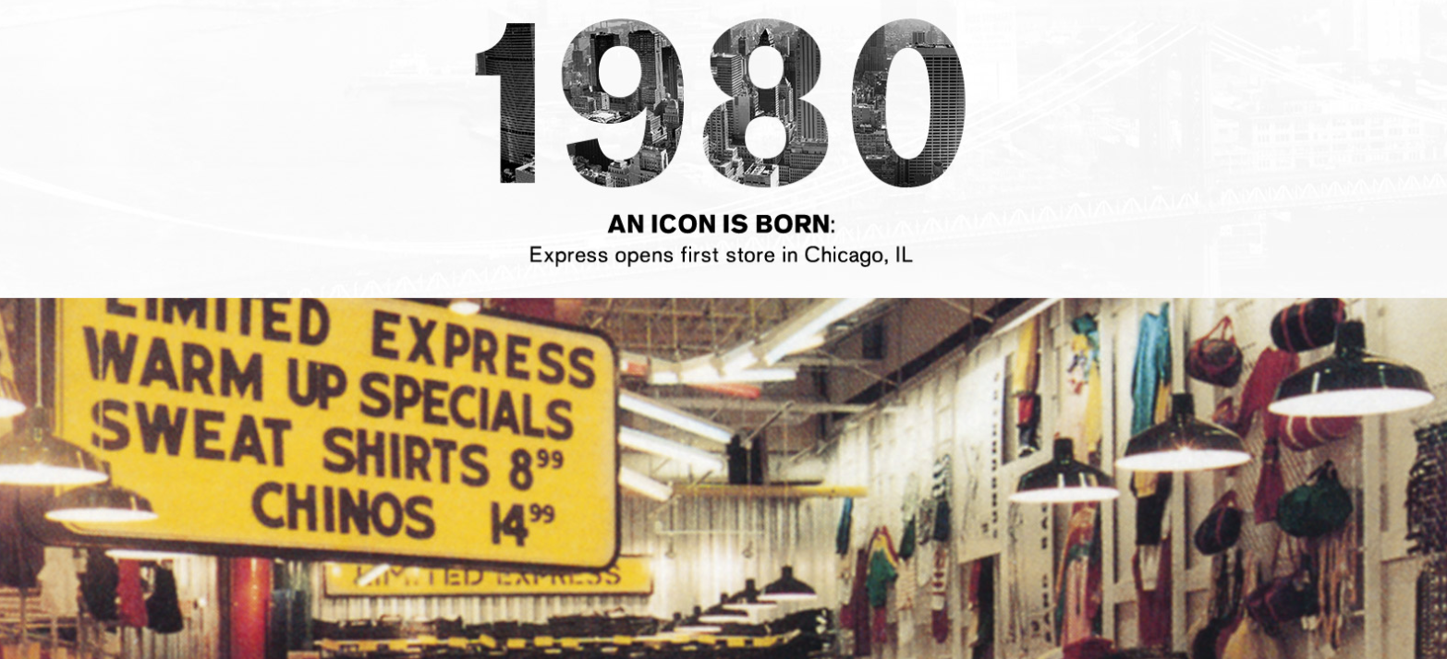
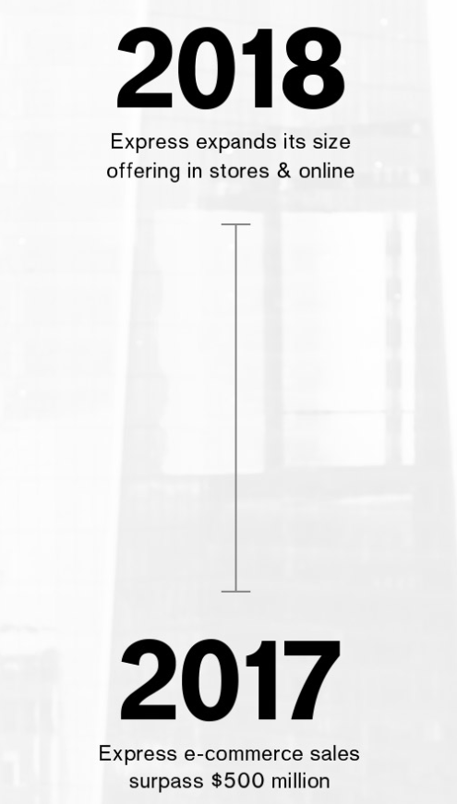
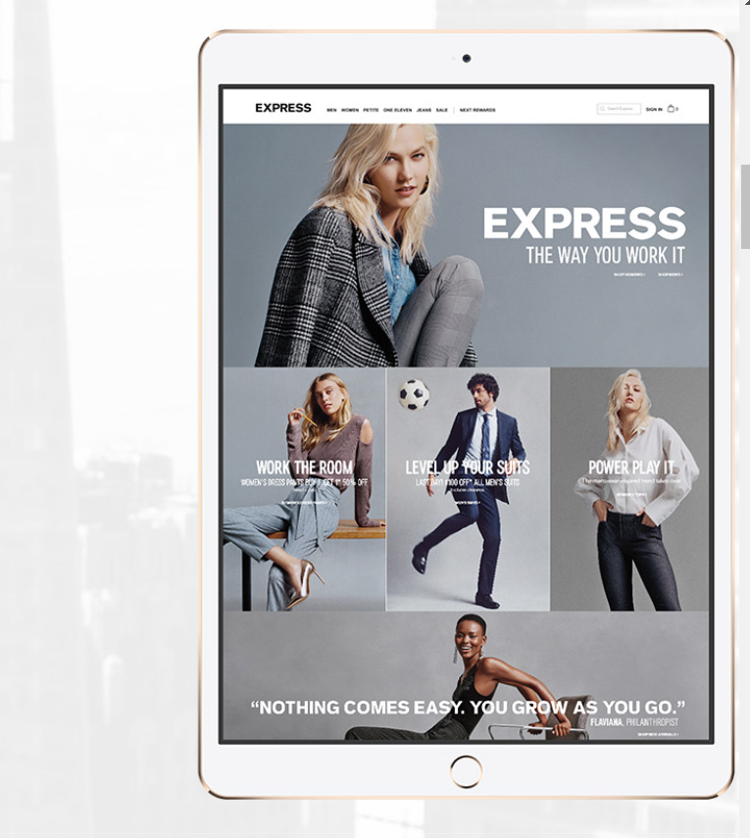
Express Inc.
Predictive lifetime value and marketing strategy
BY
APOORVA JOSHI
KAIYUE LI
KUNAL JAGDALE
PANKIT ARORA
SUJITH NAIR

Slide 2




Agenda
Executive Summary
Financial Implication
Analytics Roadmap
Customer Segmentation
Holiday Bargain Finders
Online Shoppers

Slide 3

Executive Summary
Express is an American fashion retailer that caters mainly to young men and women. Its revenue was US$ 2.192 billion in fiscal year 2016
BUSINESS OBJECTIVE
1. Identify levers that decrease time until next purchase and to evaluate the predictive lifetime value of a customer.
2. Maximize Revenue by modifying prices and product bundling.

Slide 4
Financial Implications
1. Lifetime Value of a customer segment can be increased 58% without any additional marketing cost
2. Revenue would potentially increase 7% or by $110,133 for this sample of 6676 customers by a 10% increase in prices based on customer behavior

Slide 5
Analytics Roadmap
Segmentation based on customer behavior
Market Basket Analysis
Predictive Elasticity Analysis
Survival Modeling

Slide 6

CUSTOMER SEGMENTATION

Slide 7



Customer Segmentation
Holiday Bargain Finders
Rare Visitors
The Family Guys

Slide 8
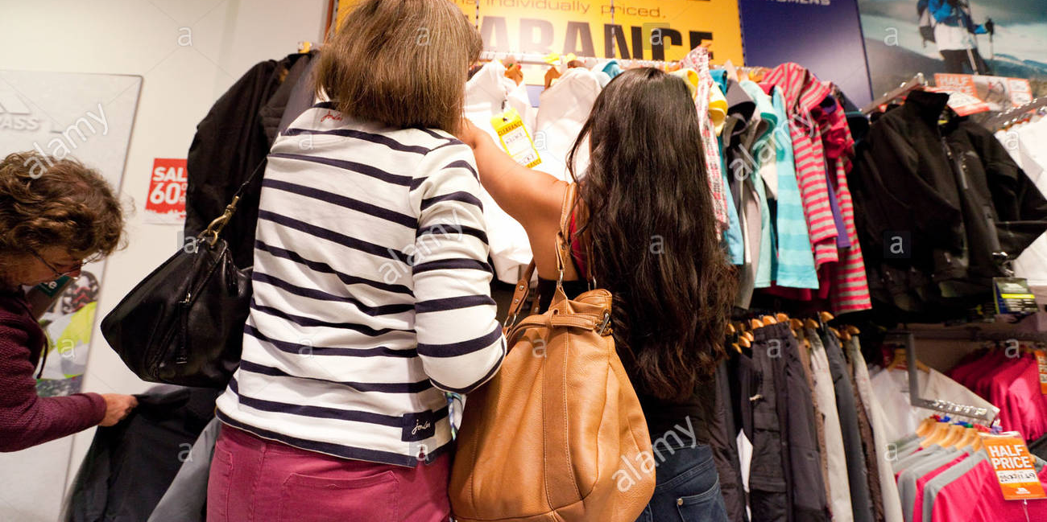

Customer Segmentation
Clearance Freaks
Online Shoppers
Millennial Variety Seekers

Slide 9
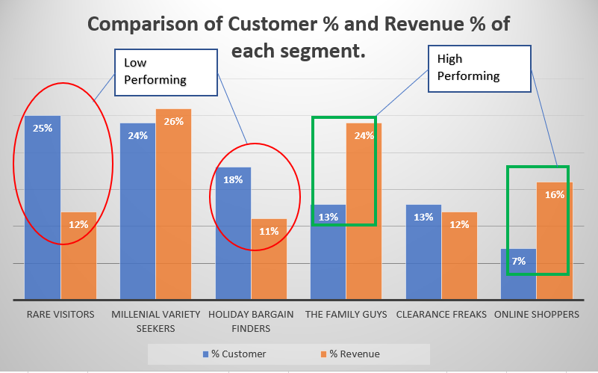

Slide 10
Segmentation

Slide 12
Online Shoppers
CHARACTERISTICS
Only 7% of customers - earn 6% of the total revenue.
85% web users
Event | Mean
timeuntil_2 | 228
timeuntil_3 | 138
timeuntil_4 | 167
timeuntil_5 | 162

Slide 13
Survival Model : Insights
Characteristics of customers that buy earlier than average. 1 unit difference in these factors decreases next purchase by indicated days :
Characteristics | timeuntil_2 | timeuntil_3 | timeuntil_4 | timeuntil_5
Direct Mails | -0.1 | 5.2 | -0.9 | -0.95
Clearance Proportion | -110.8 | -131.5 | -165.3 | -162.5
Married | -23.9 | -18.5 | -73.5 | -158.3

Slide 14
Test Plan
Saving Budget : Direct mail can be reduced 75%, which will free up 7% of Direct Mail Marketing Budget
Targeted Advertising :
Clearance Sales are likely to attract this segment to buy sooner by 143 days on average
Bachelors buy late by 70 days on average, hence should be targeted more.

Slide 15
Product Elasticity
Product | Elasticity
Women Products | 0.25
Men Products | 0.60
Women Pants | 0.60
Women Woven Tops | 0.68
Women Dress | 0.72
All the products in this segment are mostly inelastic.
Insights :
Segment Price Elasticity | % Price Increase | % Increase in revenue | Additional Revenue
0.35 | 10 | 8% | $7523.29

Slide 16
Test Plan
Product Name | Current Price | New Price | Current Revenue | New Revenue | Percent Increase in Revenue
Women Products | 4.20 | 4.62 | 13.71 | 14.70 | 7.2
Men Products | 3.05 | 3.36 | 5.60 | 5.79 | 3.4
Women Pants | 1.36 | 1.50 | 0.47 | 0.49 | 3.4
Women Woven Tops | 2.21 | 2.42 | 1.52 | 1.56 | 2.6
Women Dress | 1.10 | 1.21 | 0.41 | 0.43 | 2.1
Increasing the price of above products by 10% leads to – 5.8% increase in the revenue.

Slide 17
Market Basket Analysis
Product Name | Women Knit tops | Women Dress | Women Denim | Women Woven Tops
Women Knit tops |  | 94.20% | 8.50% | 345.70%
Women Dress | 94% |  | -33.40% | -16.70%
Women Denim | 7.40% | -33.40% |  | -0.20%
Women Woven Tops | 345.60% | -16.70% | -2.20%
Profitable bundling : Do not bundle :
Women Knit Tops + Dresses Women Denim + Dresses
Women Knit Tops + Woven Tops Women Knit Tops + Woven Tops

Slide 18
Holiday Bargain Finders
CHARACTERISTICS
18% of customers - but earn only 11% of the total revenue.
Looks for offers during holidays.
Event | Mean
timeuntil_2 | 358
timeuntil_3 | 124
timeuntil_4 | 131
timeuntil_5 | 130

Slide 19
Survival Model : Insights
Levers to decrease time until next purchase. 1 unit change in these can bring the time until next purchase by indicated decrease in days :
Levers | timeuntil_2 | timeuntil_3 | timeuntil_4 | timeuntil_5
Direct Mails | -7.5 | 3.4 | -9.4 | 2.9
Web Purchase | -179.5 | -103.6 | -114.0 | -112.4
Products Advertised | -0.4 | -1.6 | -4.2 | -15.7

Slide 20
Test Plan
1. The freed budget from Online Shoppers can be used to increase Direct Mail Budget of this segment from 15% to 22%
2. This increased budget can be utilized to send 8 additional direct mails to people who have purchased once and 2 additional direct mails to three time purchasers
3. Web exclusives promoted in direct mails to increase web purchases from 2% to 27%
4. Advertise on 3 additional product categories to each customer

Slide 21
Potential Impact
Predicted decrease in time until next 5 purchases

Slide 22
Potential Impact
Segment | Days to purchase |  |  |  | Current |  | Predicted | % increase
Holiday Bargain Finders | 2nd | 3rd | 4th | 5th | Avg Revenue Earned | Avg Visits | Predicted Revenue/Yr
Current | 358 | 482 | 613 | 744 | 137.84 | 2.17 | 187.05
Modified | 252 | 345 | 416 | 472 | 137.84 | 2.17 | 294.98 | 58%
Effect on Predictive Lifetime Value of a customer in this segment – 58% increase

Slide 23
Product Elasticity
Product | Elasticity
Women Products | 0.15
Men Products | 0.21
Women Sweaters | 0.44
Women Dress | 0.52
Men Suites | 0.53
All the products in this segment are mostly inelastic.
Overall Segment Elasticity :
Segment Price Elasticity | % Price Increase | % Increase in revenue | Additional Revenue
0.18184 | 10 | 8% | $13,276.62

Slide 24
Test Plan
Product Name | Current Price | New Price | Current Revenue | New Revenue | Percent Increase in Revenue
Women Products | 13.87 | 15.25 | 15.57 | 16.87 | 8.4
Men Products | 9.71 | 10.68 | 5.61 | 6.04 | 7.7
Women Sweater | 1.01 | 1.12 | 0.09 | 0.09 | 5.1
Women Dress | 3.53 | 3.88 | 0.65 | 0.68 | 4.3
Men Suites | 1.15 | 1.26 | 0.01 | 0.01 | 4.1
Increasing the price of above products by 10% leads to – 8.1% increase in the revenue.

Slide 25
Market Basket Analysis
Product Name | Men Casual bottom | Men Knits | Women Knit Tops | Men Shirts | Women Woven Tops
Men Casual bottom |  | 117.10% | -75.80% | 8.10% | -65%
Men Knits | 118.30% |  | -63.8% | 7.60% | -66.2%
Women Knit Tops | -63.50% | -75.50% |  | -75.20% | 90.80%
Men Shirts | 7.80% | 7.10% | -75.50% |  | -57.20%
Women Woven Tops | -64.20% | -65.20% | 90.50% | 57.30%
Profitable bundling :
Men Casual bottom + Men knits
Women knit tops + Women woven tops

Slide 26
THANK YOU

